Slide 1
Python Tutorial February 2019

Slide 2
Jupyter Notebooks Interactive
If you want to execute the code in the Jupyter Notebook, please follow the instructions in the new couple of slides.
You’ll be able to code along, and see the underlying code that generates the respective outputs.
Click the Link Below to Start an Interactive Jupyter Notebook (Chrome or Firefox)
https://mybinder.org/v2/gh/TMHP-DMO-DataScience/Python_Tutorial/master?filepath=TMHP_Python_Tutorial_I.ipynb

Slide 3
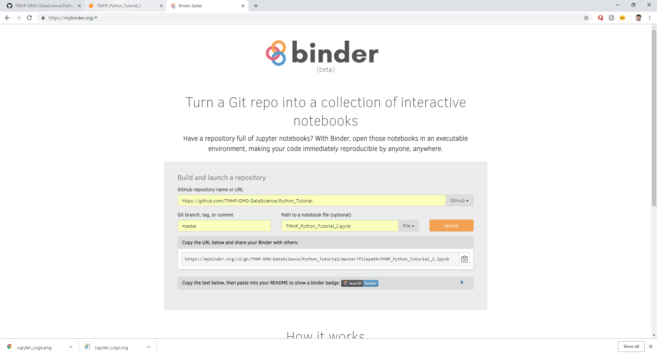
Introduction Jupyter Notebooks
Navigate to https://mybinder.org/# and input the following information in order to render an interactive Jupyter Notebook
Fill in the Following Fields:
Github Repository:
https://github.com/TMHP-DMO-DataScience/Python_Tutorial
Git Branch:
master
Path to Notebook:
TMHP_Python_Tutorial_I.ipynb

Slide 4
Jupyter Notebooks Non-Interactive
If you’d like to simply follow along without running the code, this section will show you how to render the Jupyter Notebook
Although you’ll be limited to simply viewing the notebook, you’ll still be able to view the results on your own screen.

Slide 5
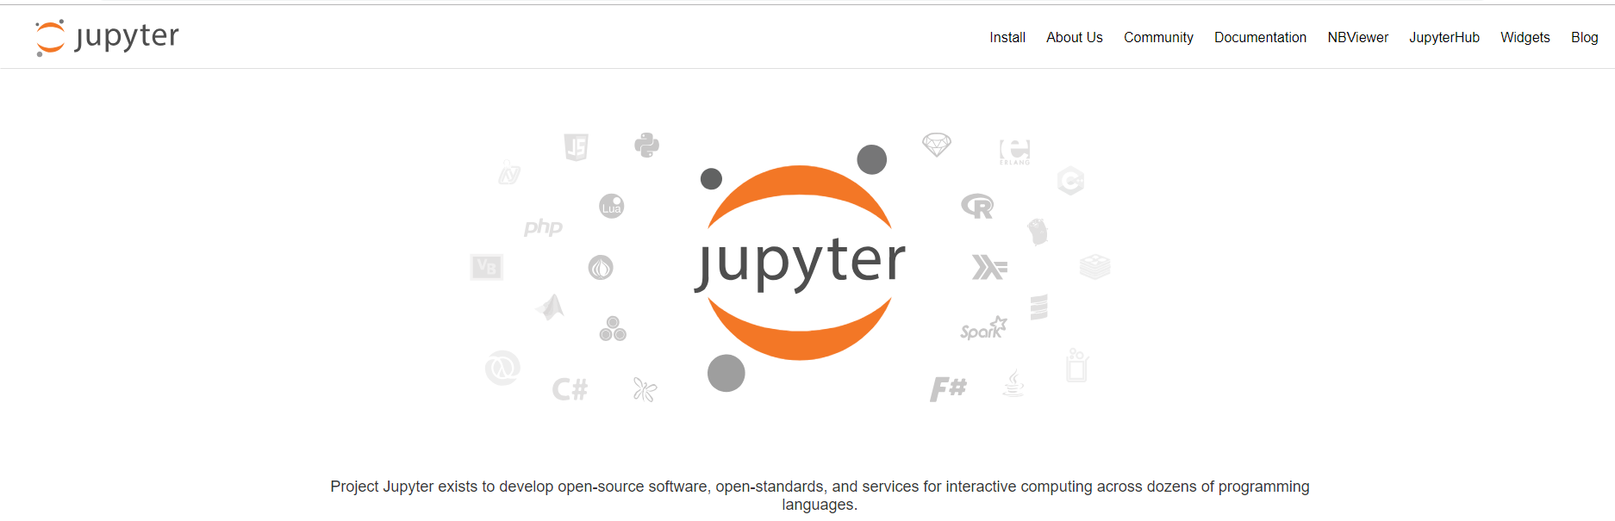
Introduction Jupyter Notebooks
Navigate to the following web address: www.jupyter.org
The landing page will look like the object to the right
Once you’re there, click on ‘NBViewer’ in the upper right hand corner

Slide 6
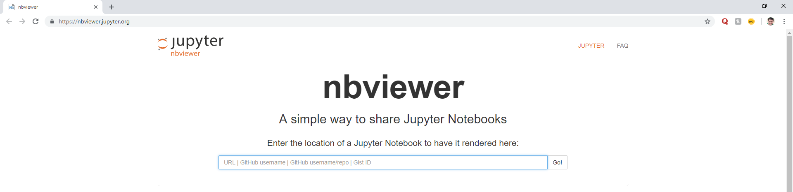
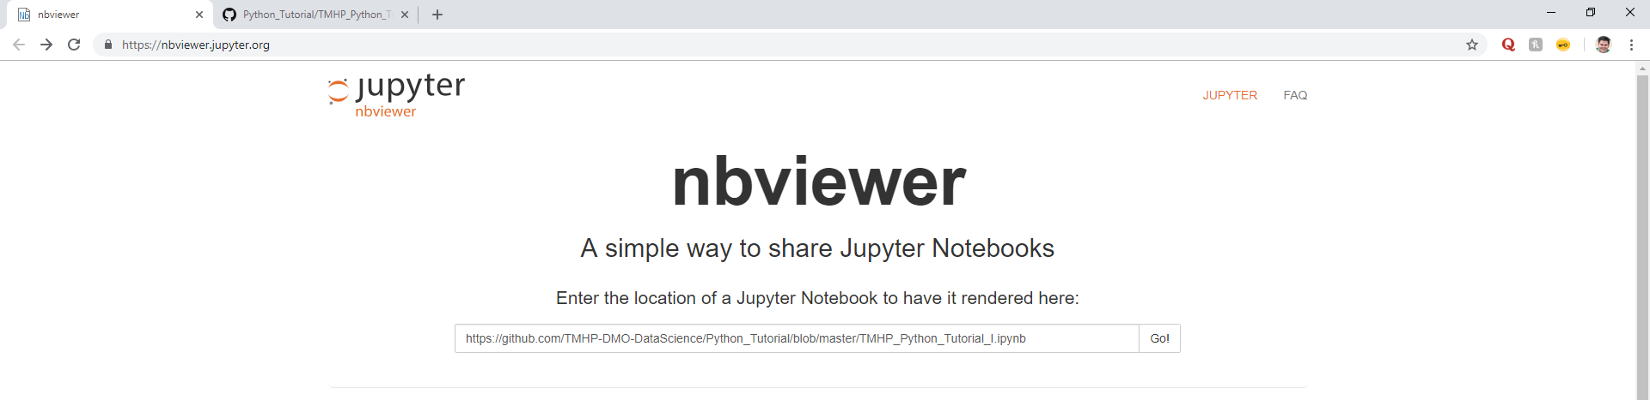
Introduction Jupyter Notebooks
Once you’ve successfully navigated to the ‘NBViewer’ page, insert the following URL into the search bar: https://github.com/TMHP-DMO-DataScience/Python_Tutorial/blob/master/TMHP_Python_Tutorial_I.ipynb
Click the ‘Go!’ button once you’ve inserted the URL

Slide 7
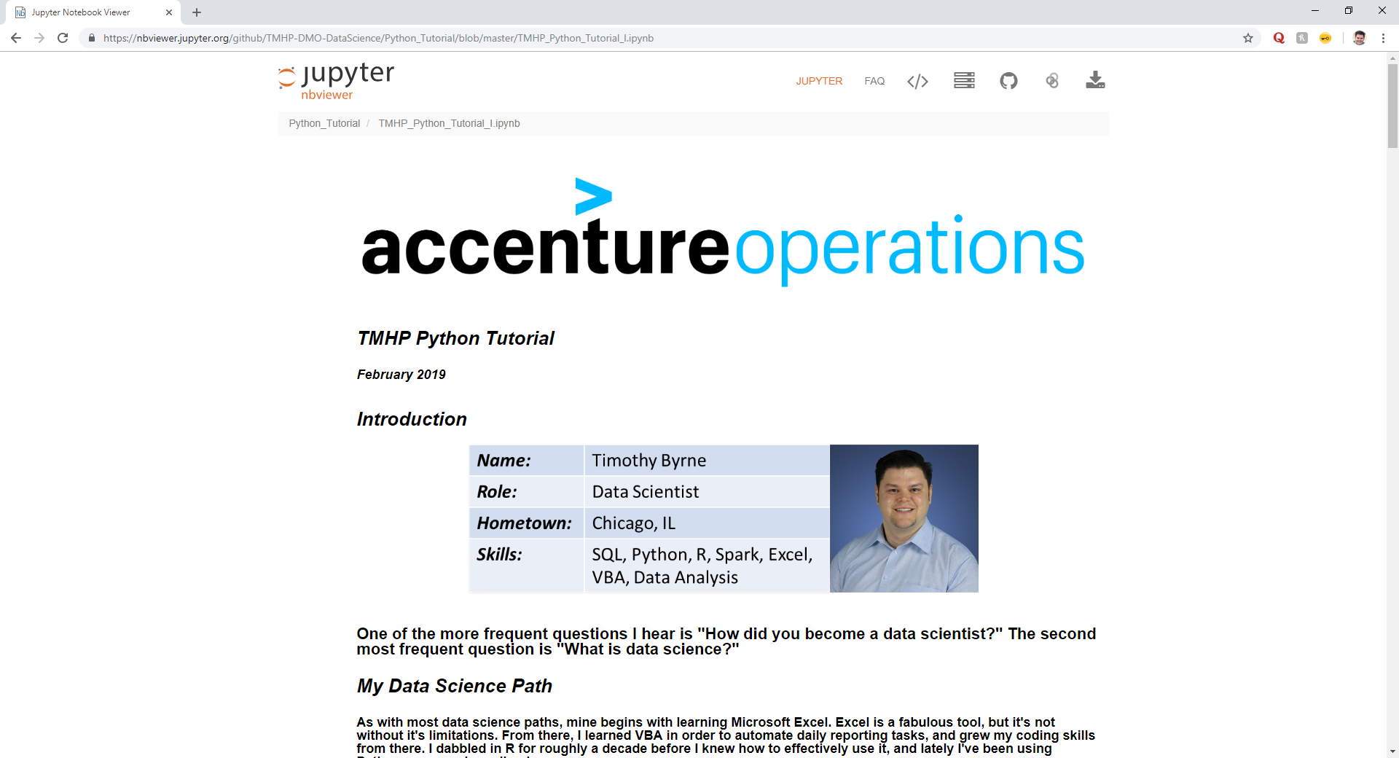
Introduction Jupyter Notebooks
If your screen looks like the screenshot to the right, Congratulations! You’ve successfully launched your Jupyter Notebook and are ready to follow along!

Slide 8
Resources Learning Paths
There are many excellent courses out there (Coursera, Udemy, eDx, etc.), but to the right are resources that I’ll use on a daily basis
Feel free to peruse the websites to the right to further your skill sets!
Description | Website
Complete Python Bootcamp: Go From Zero to Hero in Python (Jose Portilla) | https://www.udemy.com/complete-python-bootcamp/learn/v4/overview
Python for Data Science and Machine Learning Bootcamp (Jose Portilla) | https://www.udemy.com/python-for-data-science-and-machine-learning-bootcamp/learn/v4/overview
O’Reilly Safari | https://learning.oreilly.com/home/
Stack Overflow | https://stackoverflow.com/

